Slide 1
An Exploratory Analysis of Food Insecurity Patterns in Ghana.
Programming for Data Scientists 1
Group B6
Masuda Tuntaya Mashoud
Bernard Kofi Ofori Essiamah
Cephas Amoako Dakwa
Philemon Elikem Kordorwu

Slide 2
Food Insecurity in Ghana
Food insecurity is defined as the lack of consistent access to adequate, safe and nutritious food. About 36.6% of households are food insecure and more than 800,000 families are affected.
This has resulted in significant malnutrition and poor health.
However, Ghana is committed to the SDG Goal zero hunger by 2030 to help reduce food insecurity.

Slide 3
Our 5-Dimensional Analysis
Q1
Geography
How does it vary across regions?
Q2
Wealth
Does wealth protect you?
Q3
Education
Does school help?
Q4
Multiple Deprivations
Do problems come in groups ?
Q5
Urban / Rural
Are the cities different from the villages?

Slide 4
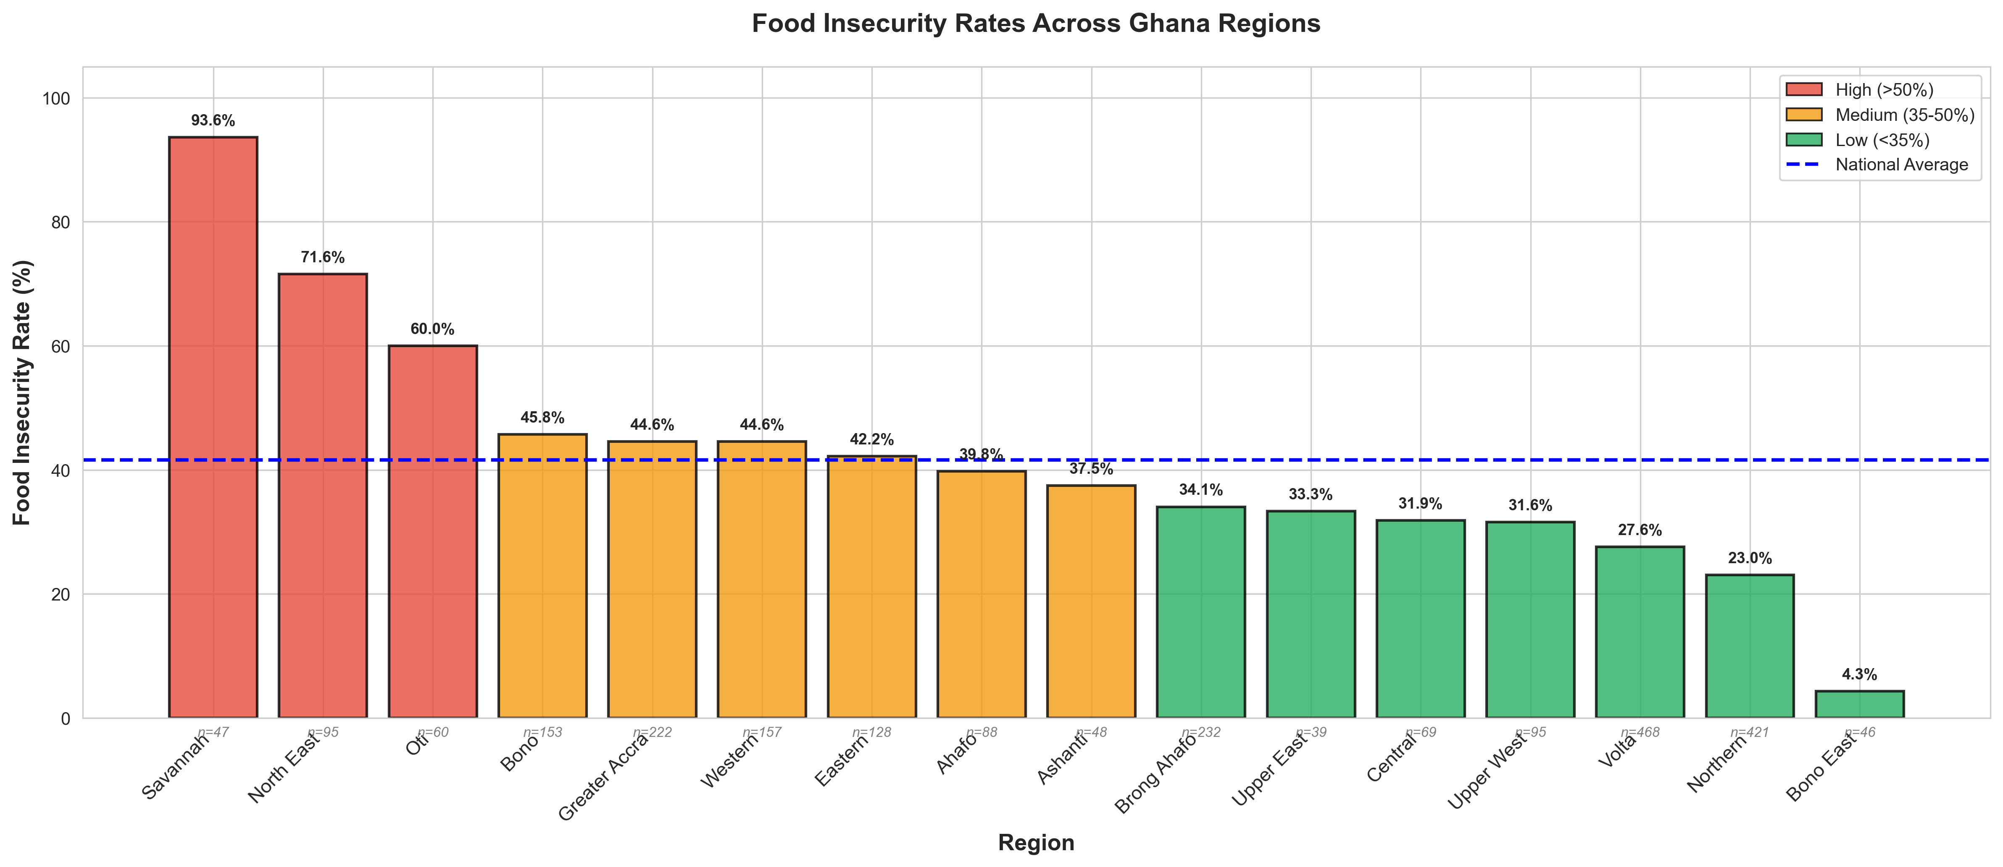
REGIONAL INEQUALITTY

Slide 5
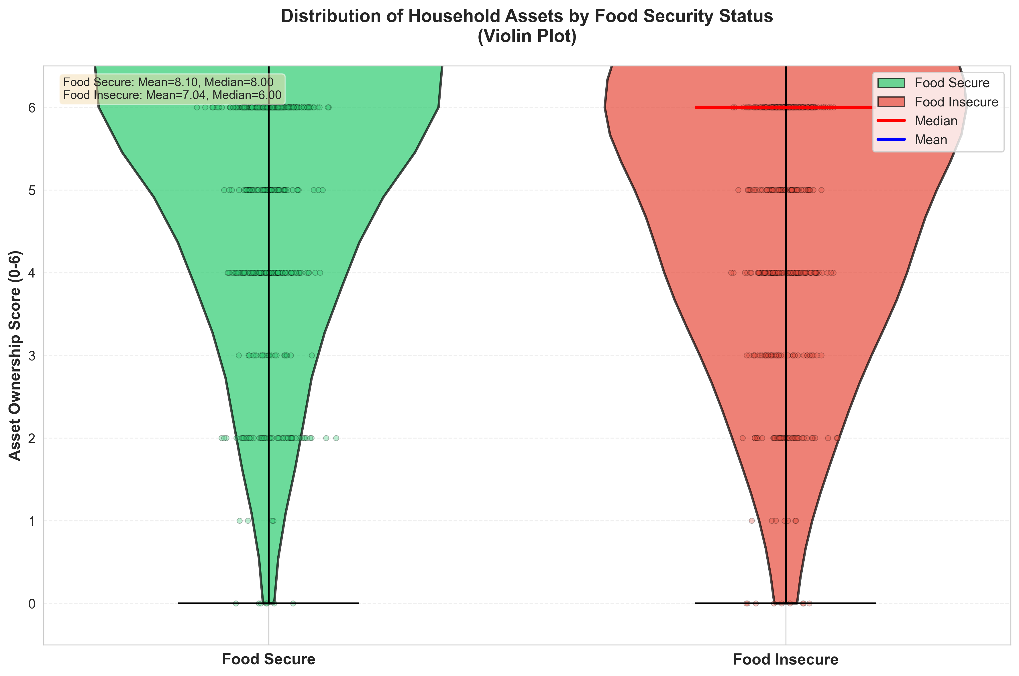
Socio-economic status and food insecurity

Slide 6
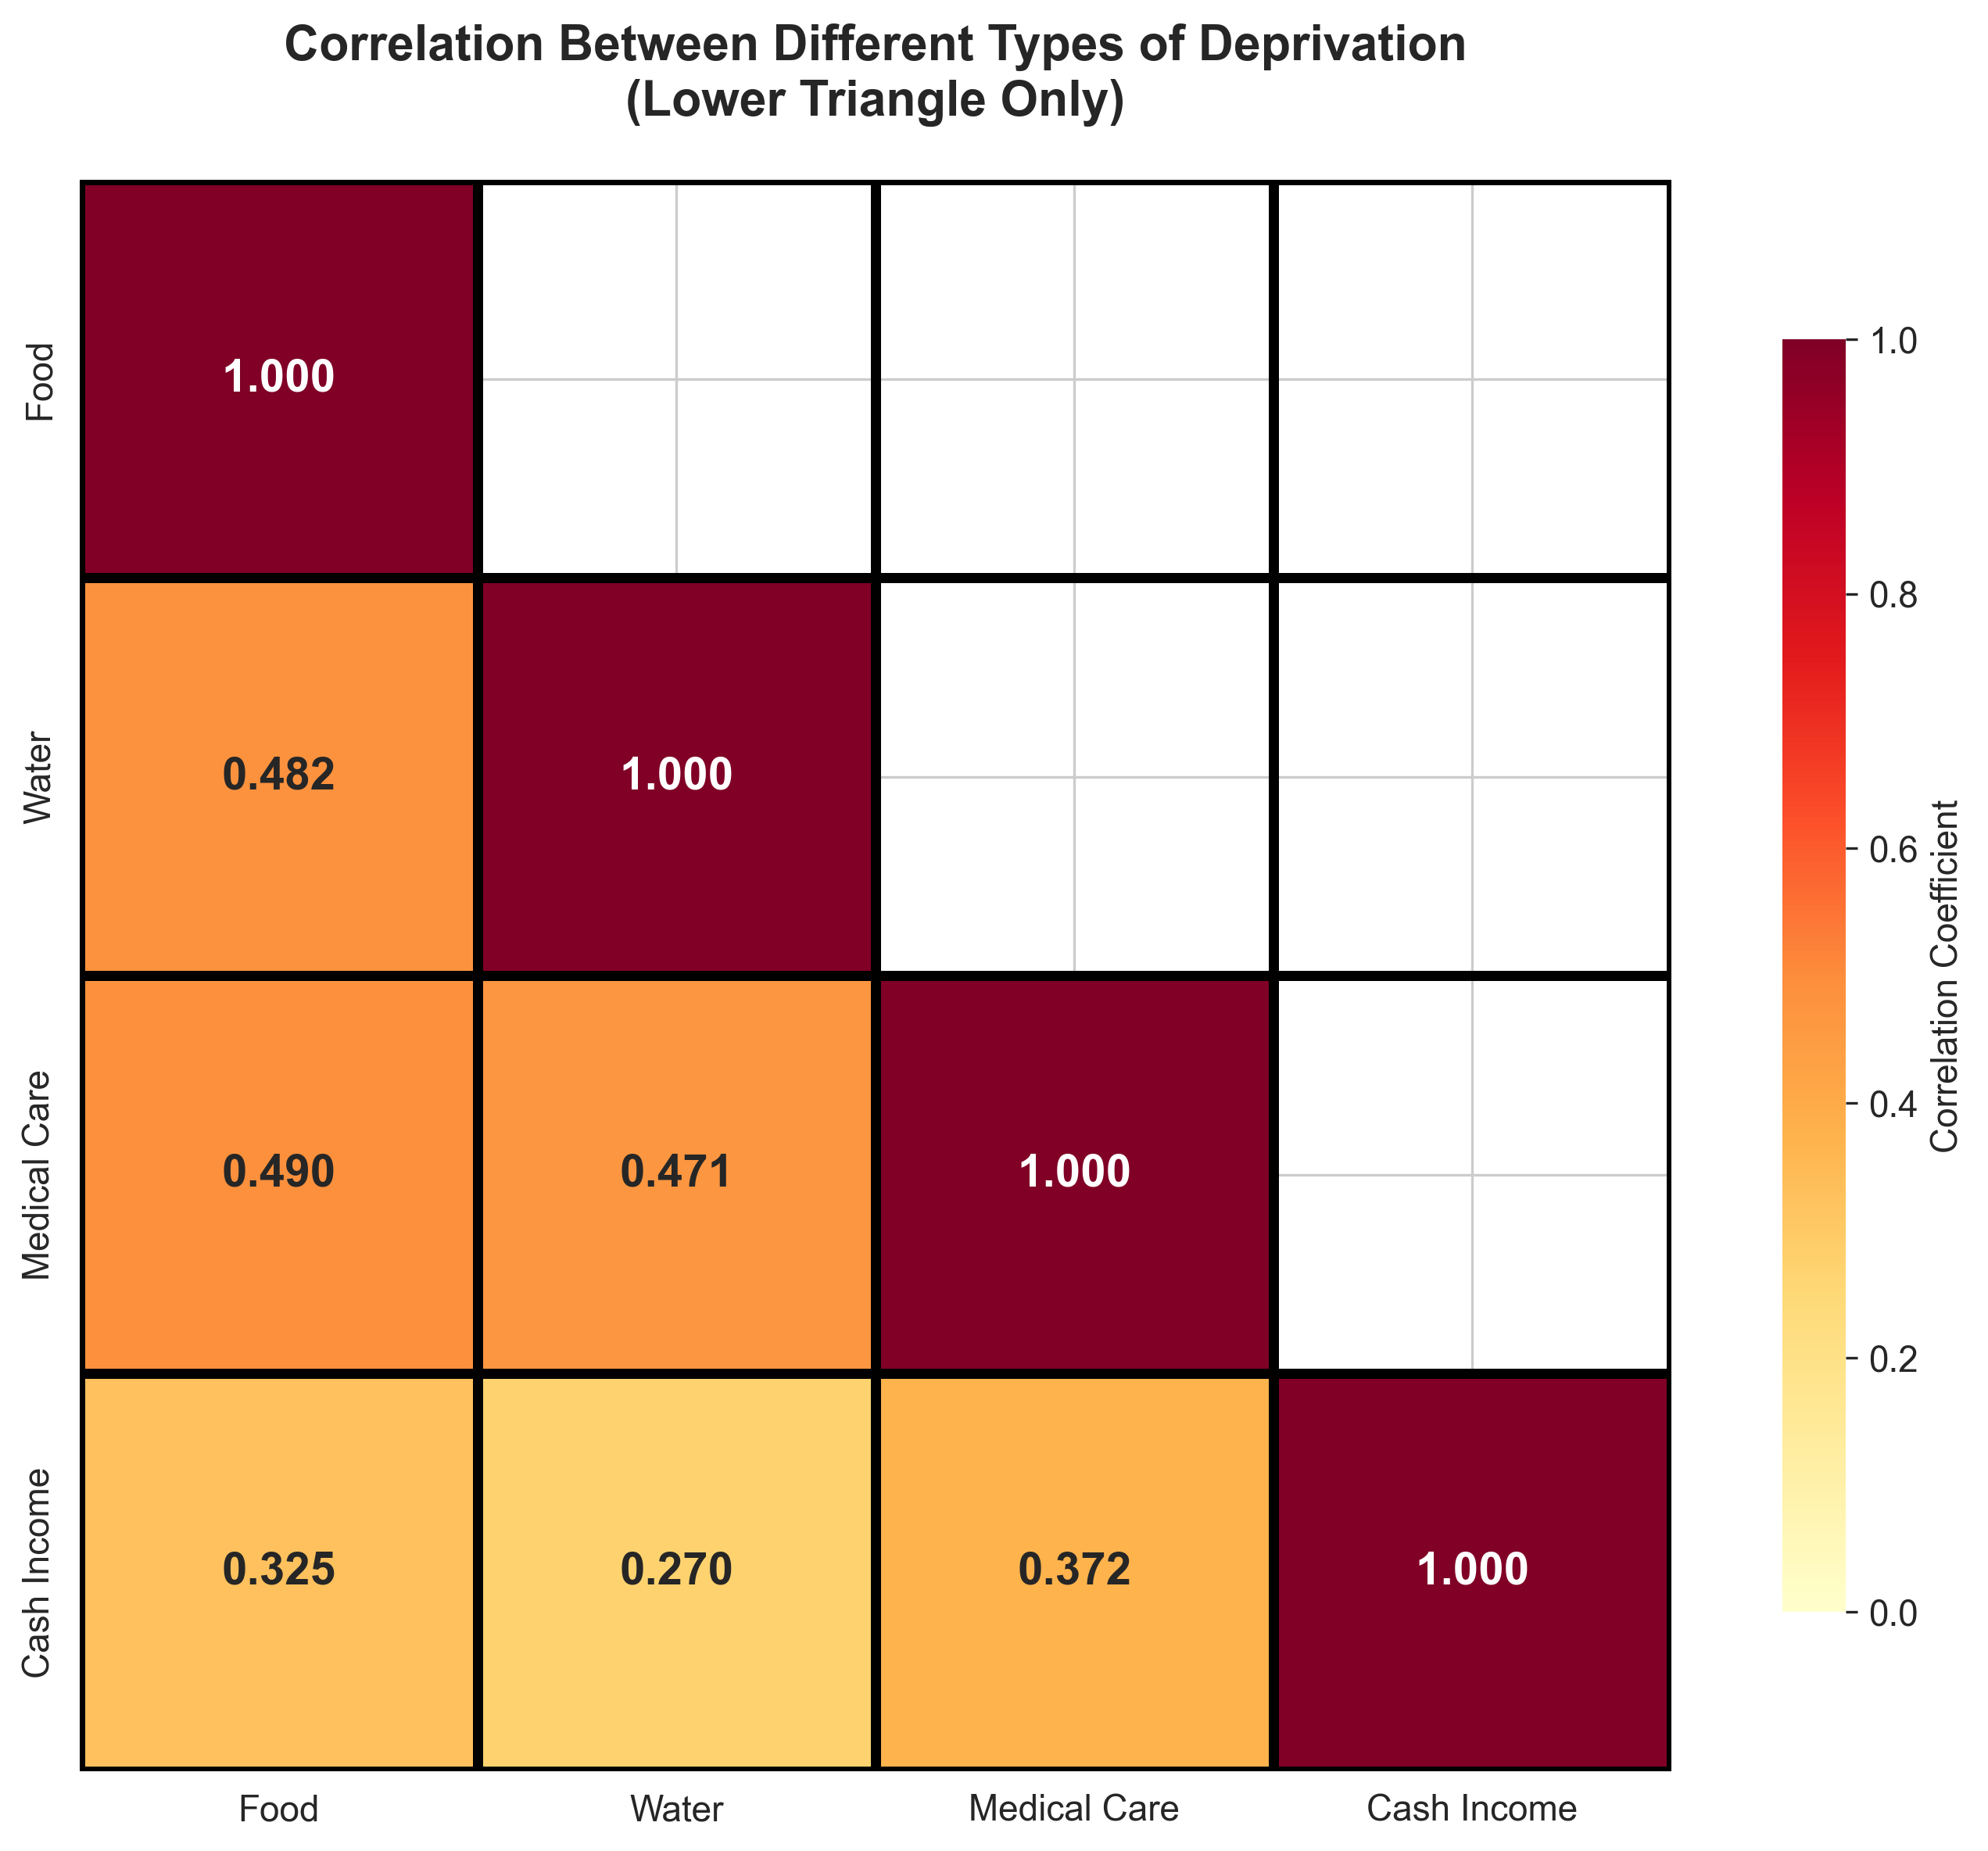
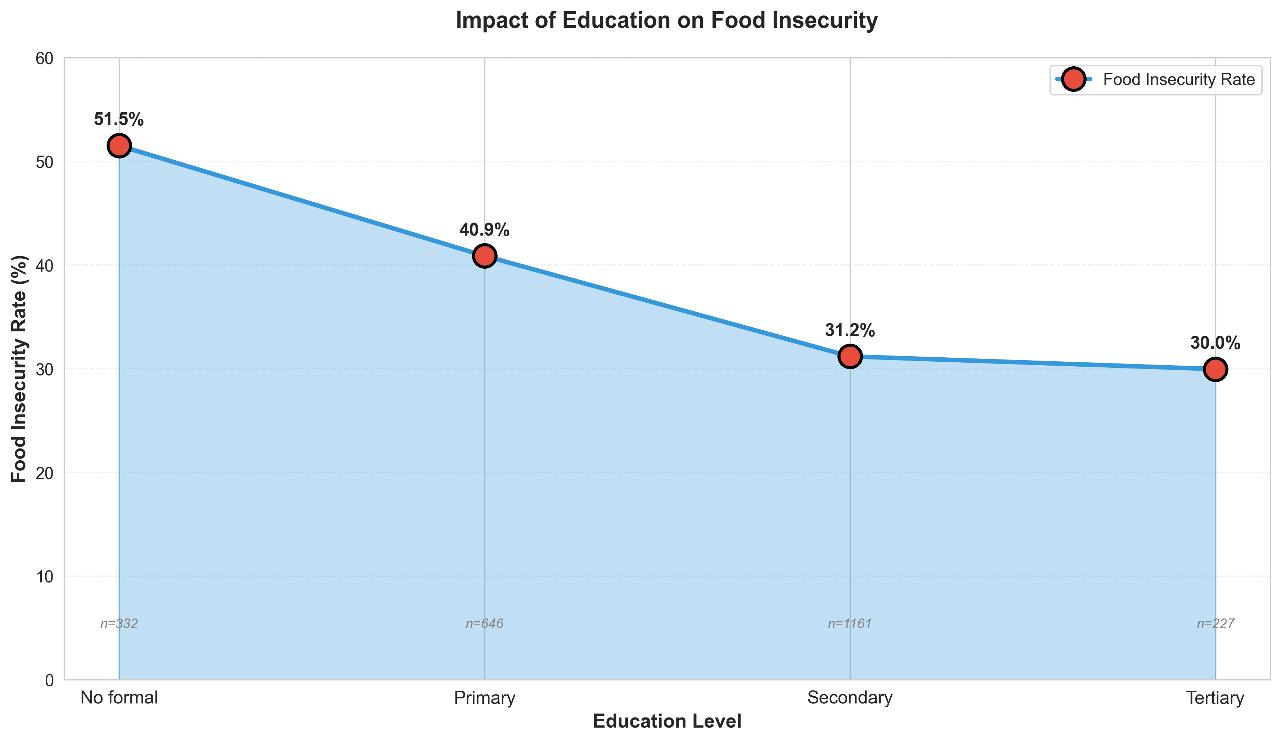
Education level / Deprivation and food insecurity

Slide 7
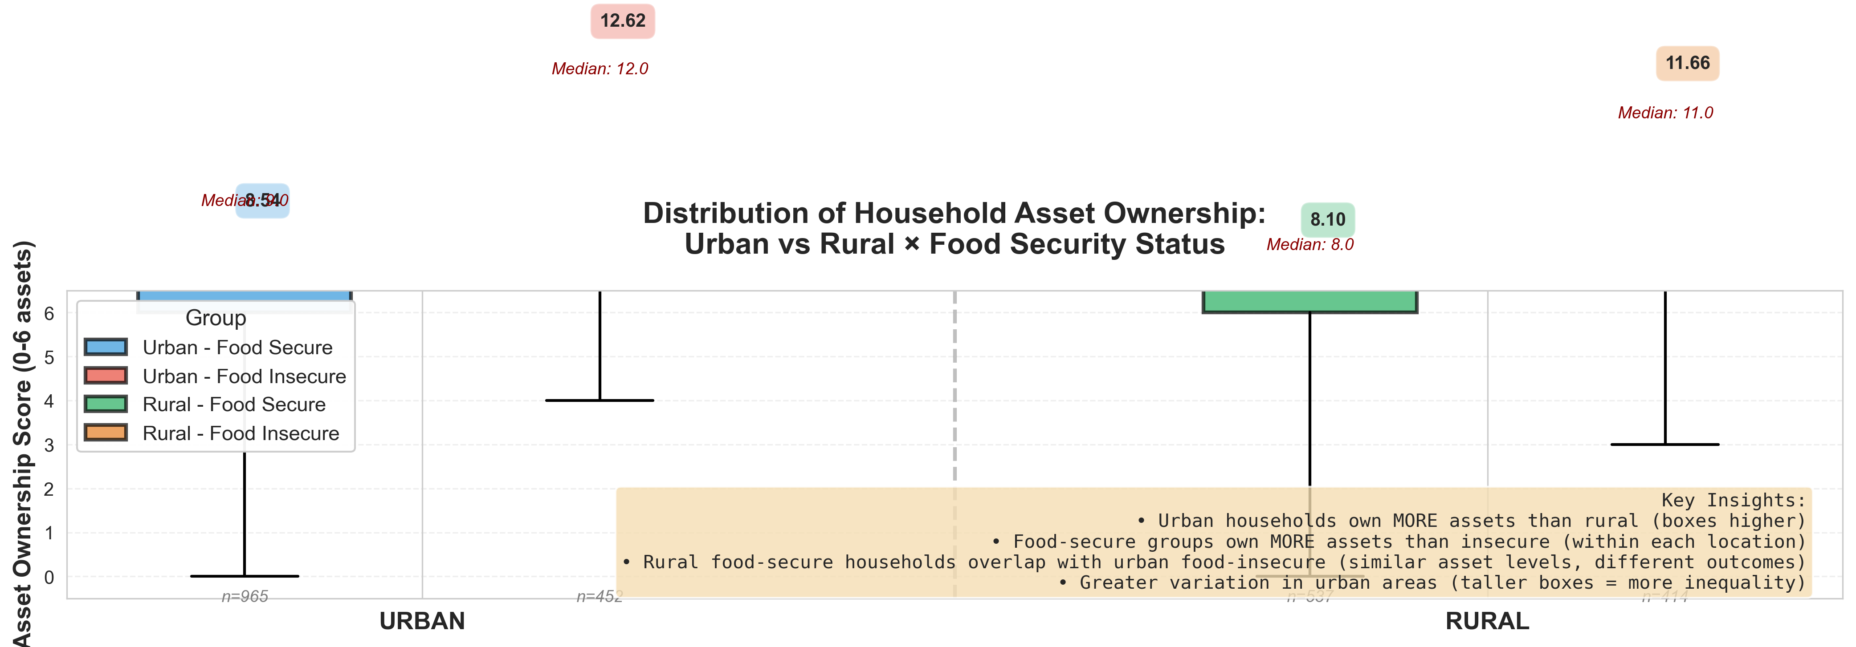
RURAL-URBAN ASSET DISTRIBUTION AND FOOD INSECURITY

Slide 8
POLICY RECOMMENDATIONS AND CONCLUSIONS
Based on our findings, we recommend an approach that addresses the emergency crises zone like savannah
We also recommend agricultural support and infrastructure in rural areas.
Invest in long-term educational projects like schools and safety nets to reduce national hunger by 2030.
IMPACTS AND LESSONS
We were able to demonstrate that through asking the right research questions and visualizations, a practical can be developed to solve societal problems.
As a team, we improved our skills in python and data visualization while working with real data.

